Slide 1


ProteX SSL/TLS Certificate Analyzer Tool Overview
The ProteX SSL/TLS Certificate Analyzer Tool is a standalone desktop application designed for cybersecurity professionals and system administrators. Developed using Python, it performs detailed audits of website security configurations focusing on SSL/TLS certificates, protocols, cipher suites, HTTP headers, DNS records, and cookie flags. This tool offers a comprehensive, offline, and GUI-driven approach to help organizations enhance their web security posture effectively.
Notes:
1

Slide 2

Security Risks Arising from SSL/TLS Misconfigurations
Expired or Self-Signed Certificates
Weak Ciphers and Outdated Protocols
Missing or Misconfigured HTTP Headers
Allow attackers to impersonate websites, leading to data interception or fraudulent transactions.
Protocols like SSLv3 and TLSv1 expose traffic to decryption and downgrade attacks.
Absence of HSTS, CSP, and secure cookie flags increases susceptibility to XSS and session hijacking.
Notes:
2

Slide 3


ProteX Tool: Comprehensive Offline SSL/TLS Analysis
SSL/TLS Certificate Retrieval
Security Headers & Protocol Checks
Fetches and inspects certificates from single or multiple domains, checking validity and trustworthiness.
Evaluates HTTP headers like HSTS, CSP, and flags insecure protocols to pinpoint vulnerabilities.
DNS & Cookie Inspection
Analyzes DNS SPF and DMARC records plus checks cookie attributes for Secure and HttpOnly flags.
Notes:
3

Slide 4
Technical Architecture & Core Modules
Language & Interface
Key Modules
Python 3.x with Tkinter GUI enhanced using ttkbootstrap for dark-themed usability.
Certificate Analyzer
Cipher & Protocol Validator
HTTP Header & Cookie Inspector
DNS Record Checker
CORS & Mixed Content Detector
Graphical Comparison Tool
Notes:
4

Slide 5
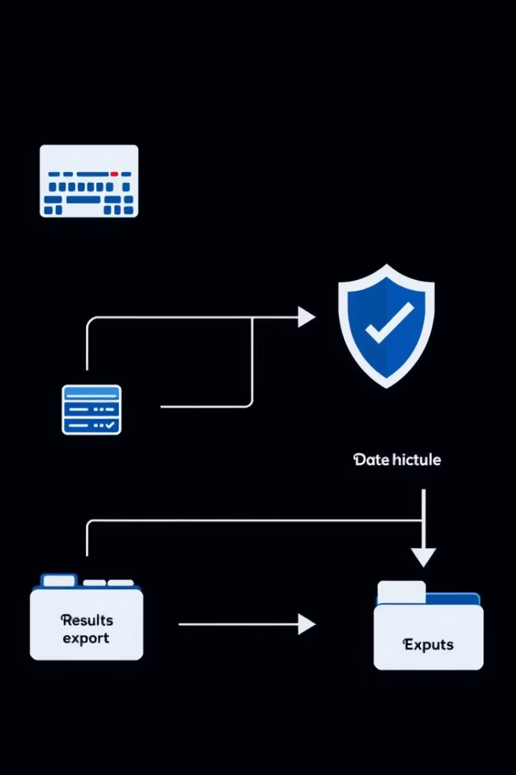
System Design & Workflow
1
User Input
Enter single or batch domain names via intuitive GUI form.
2
Automated Data Fetching
Tool retrieves SSL/TLS certificates, HTTP headers, DNS info, and cookie data.
3
Modular Analysis
Each module independently inspects different security facets for comprehensive auditing.
4
Output & Export
Results are shown visually and can be exported as detailed CSV reports for further use.
Notes:
5

Slide 6





Real-World Applications of ProteX Analyzer
System Administrators
Conduct internal audits to solidify domain security and compliance.
Cybersecurity Professionals
Identify and remediate SSL/TLS weaknesses proactively.
Developers & QA teams
Validate deployment environments’ security against SSL/TLS vulnerabilities.
Educational Institutions
Use as hands-on tool for teaching practical web security assessment.
Notes:
6

Slide 7
Testing Results & User Experience
Accuracy Metrics
Usability & Performance
Report Export
Reliable detection of expired certificates, weak or deprecated protocols, and missing headers verified on multiple domains.
Responsive graphical interface with real-time analysis feedback and proper error management for enhanced user experience.
CSV exports formatted for integration with external audits and security dashboards.
Notes:
7

Slide 8
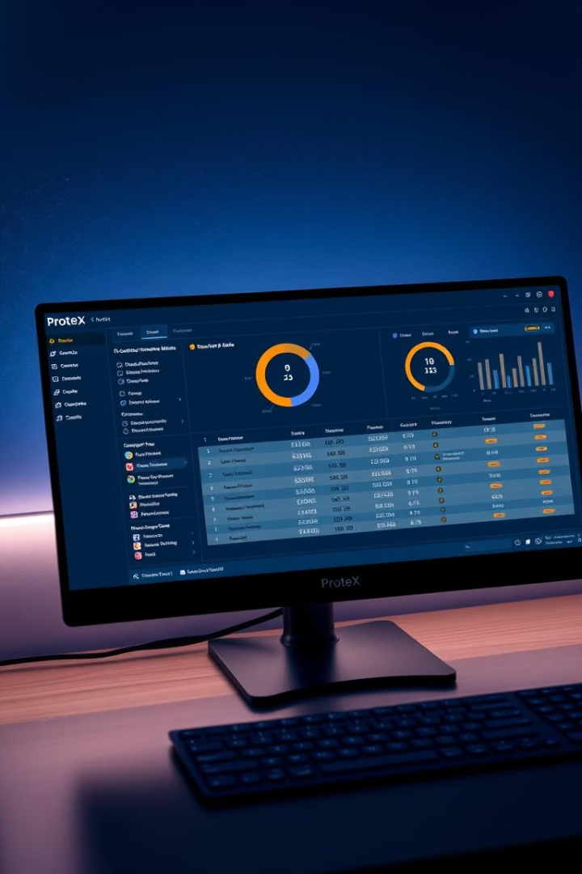
Summary & Impact of ProteX Tool
1
Balanced Depth & Usability
2
Offline Capability
Enables auditing without internet dependency or privacy concerns.
Delivers detailed security insights paired with an intuitive dark-themed GUI.
3
Extensibility & Scalability
Modular design supports future security workflow integrations and enhancements.
Notes:
8

Slide 9




Future Enhancements & Roadmap
Machine Learning Risk Scores
TLS 1.3 & Modern Cipher Support
1
Embedding AI to evaluate security posture dynamically and flag high-risk configurations.
Upgrading protocol and cipher analysis to cover latest standards for stronger security.
2
Interactive Visual Dashboard
Realtime Monitoring & Alerts
4
3
Providing graphical summaries and drill-down capabilities for complex datasets.
Implementing continuous scans with notifications for instant vulnerability detection.
Notes:
9

Slide 10

Next Steps & Adoption Strategies
Integrate Tool into Security Workflows
Adopt ProteX as part of routine security audits to identify misconfigurations early.
Customize & Expand Modules
Leverage open-source Python codebase to tailor analyses for specific organizational needs.
Invest in Training & Awareness
Use tool insights to educate staff and enforce best practices for SSL/TLS security.
Plan for Future Feature Adoption
Prepare to utilize upcoming AI and real-time alert features for proactive defense.
Notes:
10

